Slide 1
Drush importance for drupalERS

Slide 2
Who am I?
Hazrat Ali Khan Senior Software Engineer(DatumSquare IT Services)
Web Developer for 5 years but get hooked in drupal in the last 14 months

Slide 3
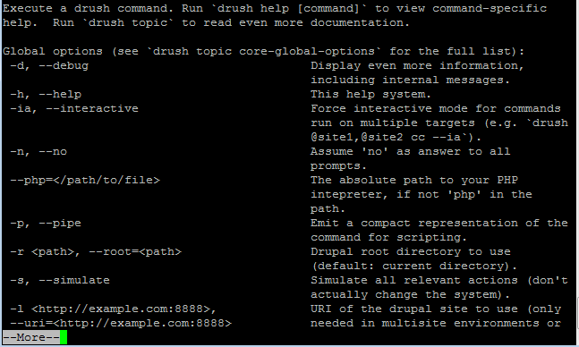
Presenting
DRUSH FOR DRUPALERS

Slide 4
What is included?
Drupal Installation using Drush
Core Commands
Project Managers Commands
User Commands
SQL Commands
Write Custom Commands

Slide 5
What is Drush?
Drush is a command line and scripting interface for Drupal, a veritable Swiss army knife designed to make life easier for those of us who spend some time
at the command prompt.

Slide 6
Drush is not a module
Drush = Drupal + Shell
+
=
DRUPAL + SHELL SCRIPTING = DRUSH

Slide 7
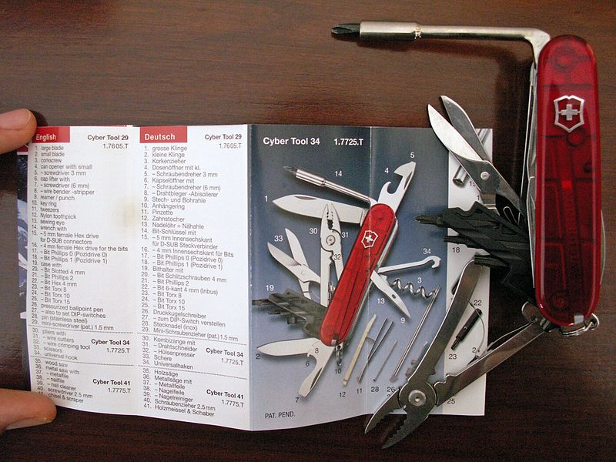
Drush is a tool
Drush provides a way of executing commands and scripts on a Drupal installation through shell or command line interface on your web server

Slide 8
Why developers love Drush?
Programmers hate work that is tedious and repetitive, drush can automate repetitive tasks.

Slide 9
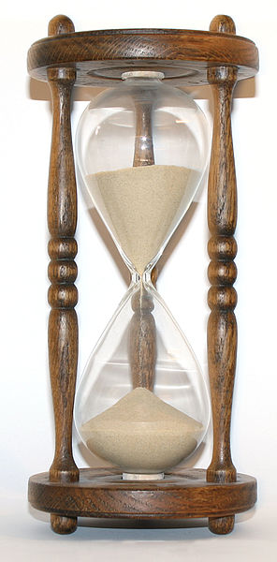
What Drush can do that GUI can’t?
Save bunch of time!

Slide 10
Why use drush?
Use drush to keep your site up to date
One installation to rule all your drupal site on your server
A must tool for system admin
Easy to remember commands
Easiest way of updating drupal website, it can update core and modules in one command

Slide 11
Other possible uses of drush
Manage modules
Manage users
Execute Drupal commands
Manipulate and extract site variables
Executes MySQL queries using drupal configuration

Slide 12
Let start using Drush!
Drush Command Structure
Command Options Arguments
In shell just type –
drush <command> [options]

Slide 13
Core Commands
cc - Clear the cache
cron - Runs all registered cron hooks

Slide 14
Project Manager Commands
dl - Downloads a module or theme
en - Enable module or theme
dis - Disable module or theme
Pm-info show detail of a module or theme
Pm-list show a list of available extensions (modules and themes)

Slide 15
User Commands
User-create (ucrt) - Create a user account with the speciﬁed name
User-information (uinf) - Print information about the speciﬁed user.
user-block (ublk) Block the speciﬁed user.
user-unblock (uublk) Unblock the speciﬁed user(s).
user-cancel (ucan) Cancel a user account with the speciﬁed name.

Slide 16
Drush SQL Commands
sql-dump Exports the Drupal DB as SQL using
sql-drop Drop all tables in a given database.
sql-query (sqlq) Execute a query against the site database.

Slide 17
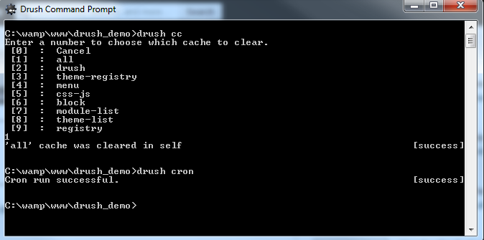
Let’s see it in action!
Time for demonstration

Slide 18
Resources and Useful Links
http://drush.ws/resources
http://www.developmentseed.org/blog/2009/jun/19/drush-more-beer-less-effort/
http://www.only10types.com/2011/03/drush-backup-and-migrate-command.html
http://www.slideshare.net/SergeiStryukov/drush-why-should-it-be-used
http://drupal.org/node/484720
http://drupal.org/node/670460

Slide 19
Many Thanks!
THANK YOU ALL!

